Slide 1
Tuesday Talk
10.20.20
Courtney Warnsman, Trustee
cwarnsman@austincareerconnections.com
Please mute microphones and use hand-raising feature.

Slide 2
Tuesday talk topics, 10.20.20
NCDA November Virtual CPI
Tuesday, November 10th 11:00am-5:00pm Eastern. Register on NCDA web site.
Live sessions, recorded sessions, live constituency meeting
Submitting articles for NCDA publications--
Career Convergence Web Magazine (Practical tips, 950 words maximum)
CDQ/Career Development Quarterly (Primary research, lit reviews, etc. up to 25 pages depending on purpose)
See NCDA.org under “Publications” for more information about submission
Follow up from September meeting:
Mentoring partnerships
Document sharing site—Allow emails? Who knows how to do it? Can go on NCDA web site. Ethics committee.
Resilience session with Sharon Givens—Getting through the Holidays and Kicking off the New Year
Thursday, December 3rd 5:30 pm CST (continuing every other month)
Watch for new log in for next month
Polls and Discussion

Slide 3
Tuesday Talk
10.20.2020
Courtney Warnsman, Trustee
Please mute microphones and use hand-raising feature.

Slide 4
Tuesday talk topics, 9.15.20
NCDA Virtual Conference Debrief. What was your greatest takeaway?
Follow up from the constituency meeting
Monthly Zoom Resilience Meeting
LinkedIn Conversations
Continued Tuesday Talks
Support for agencies as pandemic eases
Free resources, tools, activities, assessments for cash assistance (formerly welfare) clients.
Private Practice--Is liability insurance necessary? If so, where do you purchase it?
Revisiting mentoring partnerships

Slide 5
Tuesday talk topics, 6.16.20
Current trends & insights—General discussion & insights from LinkedIn’s Virtual Conference: Navigating the New World of Work
Career services in the midst of protests & pandemics
Remembering your early career—Struggles, imposter syndrome, what do you wish you had known in the beginning?
Informal mentoring partnerships—Taking the conversations past Tuesday Talks
Social Media Managers & Virtual Assistants—How are you using them in your practice? Cost?
Constituency LinkedIn Group
NCDA Virtual Conference (No July Tuesday Talk)

Slide 6
Sources of following slides:
Karin Kimbrough, Chief Economist at LinkedIn
Melissa Thompson, SVP Talent Acquisition at Nielsen
During LinkedIn’s Virtual Conference, Navigating the New World of Work, 6.4.20

Slide 7
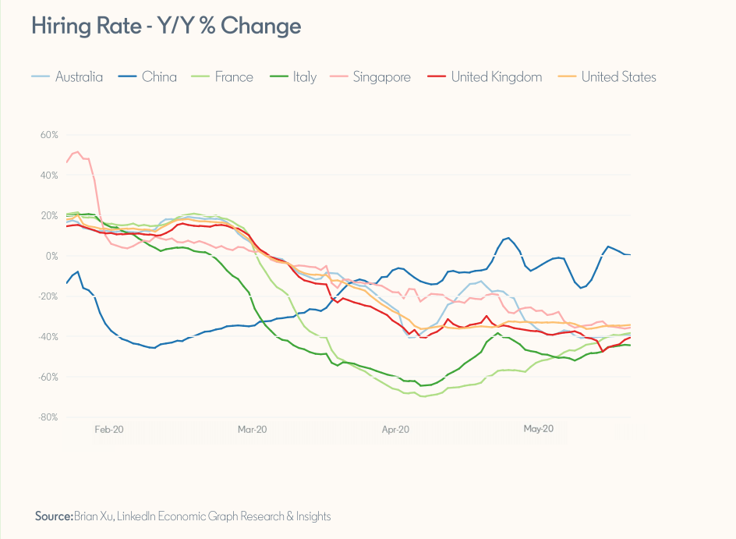

Slide 8
Current Hiring Trends
Longer time to hire
Delayed start dates
Pipelining

Slide 10
General thoughts
3 years to “normal”
7 years to where we were right before pandemic

Slide 11
Tuesday talk topics, 6.16.20
Current trends & insights—General discussion & insights from LinkedIn’s Virtual Conference: Navigating the New World of Work
Remembering your early career—Struggles, imposter syndrome, what do you wish you had known in the beginning?
Informal mentoring partnerships—Taking the conversations past Tuesday Talks
Social Media Managers & Virtual Assistants—How are you using them in your practice? Cost?
NCDA Virtual Conference (No July Tuesday Talk)

Slide 12
Tuesday Talk topics May 19, 2020
Ideas for private practice counselors to pivot toward new/current needs.
Insights and trends about outplacement service needs. What are employers paying/not paying for?
Own professional development during this time? Which credentials? Which certifications? MBTI, Birkman, Resume Writing, Other?
Fee structure revisited. How to increase income. Virtual billing?

Slide 13
Tuesday Talk Topics April 21, 2020
Which industries/professions are hiring during the pandemic (besides the obvious healthcare, etc.?)
Who is expected to be hiring when things open up again?
Instilling hope in clients during this time
Helping clients work through taking risks
Maintaining/Boosting client engagement
Advising clients on staying engaged with their teams
Advising clients on relaying accomplishments to demonstrate productivity
Best practices for leading virtual webinars (especially Blackboard)

Slide 14
Tuesday talk Topics/questions, March 2020 Please mute your microphones when you are not speaking
Virtual Career Services: Tips & Tools; Legalities; Best Practices
Job Market: Who’s hiring? Who’s not?
Helping Clients through Fear of Taking Risks
Self Care

Slide 15
Tuesday talk Topics/questions, feb 2020 Please mute your microphones when you are not speaking
New evolving careers
New ways of working
Helpfulness of Jobscan; free or subscription version
Ideas for more visual and kinesthetic learners

Slide 16
Topics/questions, Jan 2020
Introductions and Purpose
Comprehensive Guide to Career Assessment (Online and 7th Edition Print Version)
Best online platforms for updating and revising resumes
ATS Tips
Submitting articles for Career Convergence

